Slide 1

EI Middle East Branch
Good practice steps to effective PSM
Dr. Mark Scanlon – HSE Team Manager – Energy Institute
11/11/2013
www.energyinst.org

Slide 2

EI: KNOWLEDGE, SKILLS AND GOOD PRACTICE
Networking
Publications
Knowledge
EI: Sharing energy knowledge…
Membership Organisation
Energy Institute
Learned Society
Recognition
Good practice
Facilitation
Training and events
Professional development
www.energyinst.org

Slide 3

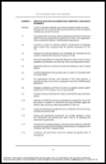
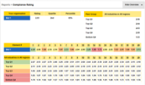
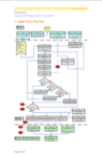
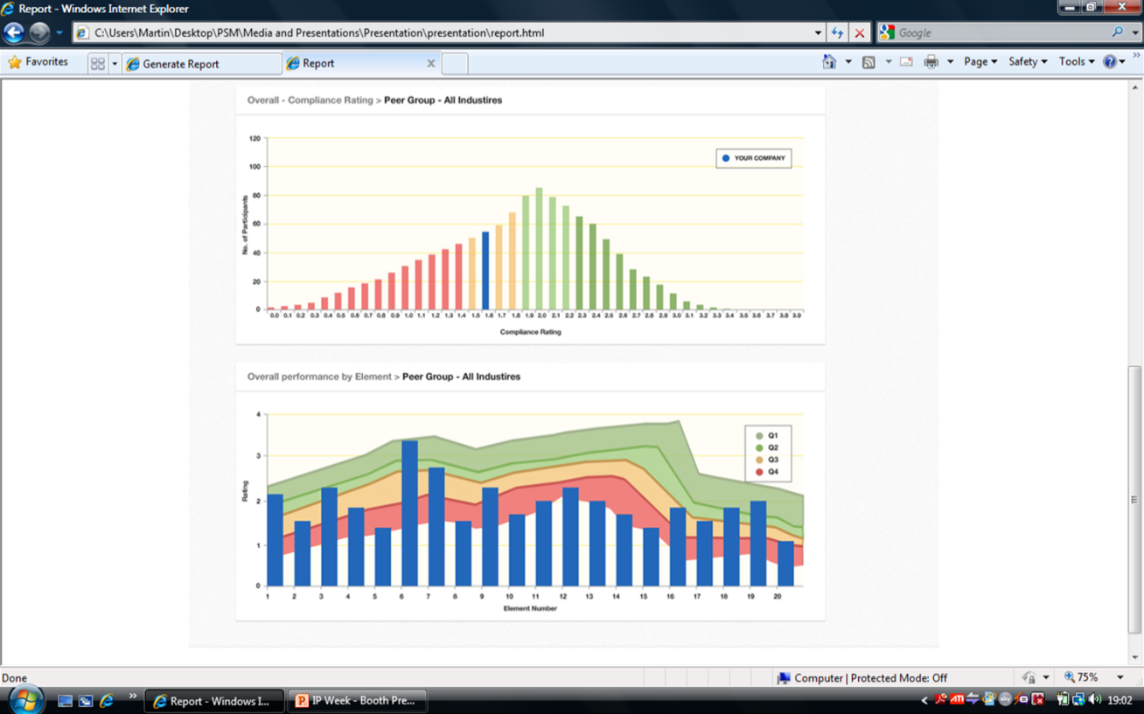
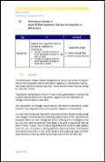

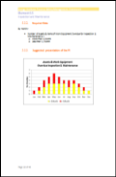
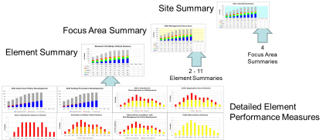
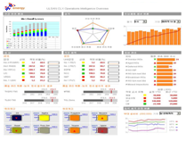
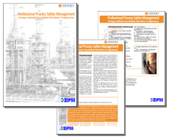
PRESENTATION TOPICS
5 Good practice steps to effective PSM
EI PSM framework (PSMF)
EI Process Safety Survey (EIPSS)
EI PSM guidelines (PSMG)
Performance measures
Competency profiles programme
www.energyinst.org

Slide 4
PRESENTATION TOPICS
5 Good practice steps to effective PSM
EI PSM framework (PSMF)
EI Process Safety Survey (EIPSS)
EI PSM guidelines (PSMG)
Performance measures
Competency profiles programme
www.energyinst.org

Slide 5
STEP 1: DEFINING PSM
EI Process Safety Committee definition of process safety:
Process safety is a blend of engineering and management skills focused on preventing catastrophic accidents and near misses, particularly structural collapse, explosions, fires and toxic releases associated with loss of containment of energy or dangerous substances such as chemicals and petroleum products. These engineering and management skills exceed those required for managing workplace safety.
(Adapted from Center for Chemical Process Safety of the American Institute of Chemical Engineers)
What an energy industry should do on a strategic, tactical and day-to-day basis to deliver operational excellence.
Incorporates all of the disciplines, processes and procedures essential in ensuring the integrity of energy industry assets (asset integrity management (AIM)).
www.energyinst.org

Slide 6


STEP 1: COMPANY OBJECTIVES – BUT HOW?
Make or exceed the fiscal target
Don’t hurt anyone
Don’t harm the environment
www.energyinst.org

Slide 7
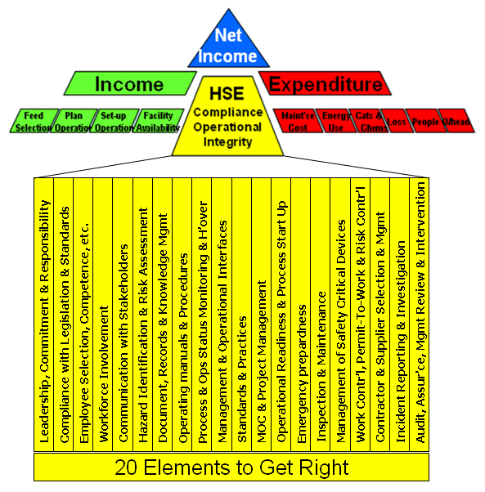
STEP 1: PSM – KEY TO CONTROLLING OPERATIONAL RISK
Prioritise emergent activities, manage expenditure
Reduce unplanned downtime, deliver production
Manage operational risk
www.energyinst.org

Slide 8





STEP 1: NEED TO KNOW
Senior executives need to know ‘How likely am I to have an incident-free day tomorrow?’
The two key questions are:
How will we do that?
How will we know we are doing it?
“I think” means “I don't know”
www.energyinst.org

Slide 9
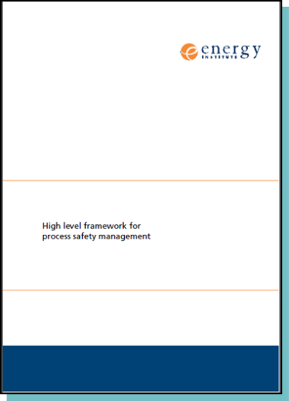
STEP 1: EI PSMF
EI Process Safety Committee developed High level framework for process safety management (PSM framework) (EI PSMF), 1st edition, December 2010, ISBN 978 0 85293 584 2), register for free single user download www.energyinst.org/technical/psm/PSM-framework
Development approach:
Workshops with participants representing a cross-section of the energy industry sectors and stakeholders, including industrial insurers, UK HSE, etc.
Subsequent wider stakeholder review.
Developed “for the industry, by the industry”
Represents current energy industry PSM good practices.
Comprehensive.
Structured.
Endorsed and adopted by UK HSE (regulator).
Other ‘industry’ PSM resources are available.
www.energyinst.org

Slide 10
STEP 1: PSMF STRUCTURE
Increasing detail
Focus areas
– 4 high level key components of the PSMF.
Elements
– 20 key aspects of the operation that need to be managed appropriately in order to assure the integrity of the operation.
Expectations
– 202 things we should be doing in order to assure the integrity of the operation.
Guidelines
– 20 publications on how to meet the Expectations: good practices and performance measures (PSPIs) (See steps 3 and 4)
www.energyinst.org

Slide 11


STEP 1: PSMF ‘ELEMENTS’
01 Leadership Commitment & Responsibility
02 Identification & Compliance with Legislation & Industry Standards
03 Employee Selection, Placement and Competency and Health Assurance
04 Workforce Involvement
05 Communication with Stakeholders
11 Standards & Practices
12 Management of Change & Project Management
13 Operational Readiness & Process Start-up
Emergency Preparedness
Inspection & Maintenance
Management of Safety Critical Devices
Work Control, Permit to Work & Task Risk Management
Contractor & Supplier Selection & Management
Process safety leader-ship
Risk manage-ment
Risk identif-ication and assess-ment
06 Hazard Identification & Risk Assessment
07 Documentation, Records & Knowledge Management
08 Operating Manuals & Procedures
09 Process and Operational Status Monitoring and Handover
10 Management of Operational Interfaces
19 Incident Reporting & Investigation
20 Audit, Assurance and Management Review & Intervention
Review and improve-ment
www.energyinst.org

Slide 12
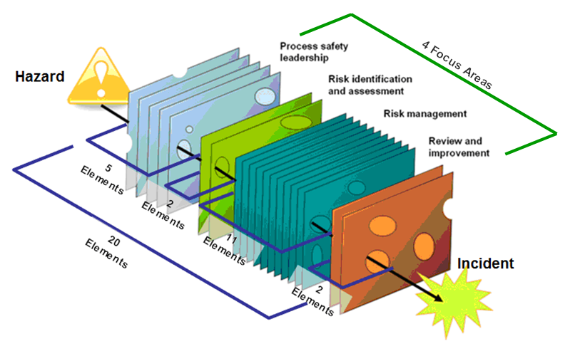
STEP 1: PSMF REPRESENTED AS ‘BARRIERS’
01 Leadership Commitment & Responsibility
02 Identification & Compliance with Legislation & Industry Standards
03 Employee Selection, Placement and Competency and Health Assurance
04 Workforce Involvement
05 Communication with Stakeholders
11 Standards & Practices
12 Management of Change & Project Management
13 Operational Readiness & Process Start – up
Emergency Preparedness
Inspection & Maintenance
Management of Safety Critical Devices
Work Control , Permit to Work & Task Risk Management
Contractor & Supplier Selection & Management
06 Hazard Identification & Risk Assessment
07 Documentation, Records & Knowledge Management
08 Operating Manuals & Procedures
09 Process and Operational Status Monitoring and Handover
10 Management of Operational Interfaces
19 Incident Reporting & Investigation
20 Audit, Assurance and Management Review & Intervention
www.energyinst.org

Slide 13
STEP 1: PSM FRAMEWORK EXPECTATIONS
E.g. PSMF Expectations for Element 16 - Management of safety critical devices
An essential requirement for HS&E and process safety is that safety critical equipment and devices (SCDs) are in service and operating correctly.
Management must ensure that safety critical equipment and devices are identified and appropriately managed, so that they are in service and functioning correctly.
16.1 SCDs are uniquely identified on an asset register which provides up-to-date asset lists and equipment records, including location and equipment specification data. The asset register provides a basis for the planning of SCD testing, inspection and maintenance.
16.2 SCD testing, inspection and maintenance programmes are in place. There are defined standards and the programmes are proportionate to the risk associated with failure of the SCDs.
16.3 There are procedures to ensure that SCD testing, inspection and maintenance programmes are reviewed regularly commensurate with risk, using findings from the programme, industry experience and incidents to identify and address issues and opportunities for improvement, so that they are kept up to date as living systems.
16.4 Etc.
www.energyinst.org

Slide 14
STEP 1: PSMF APPLICATION
EI PSMF can be applied to:
Any region (geography)
Any industry sector:
Oil and gas – E&P through to filling stations
Chemical manufacturing and storage
Power – Generation through to distribution
EI PSMF doesn’t replace existing HS&EMS but provides a consistent reference baseline for:
Profiling compliance – identification of strengths and weaknesses
Gap assessment and development of improvement plans
Benchmarking (using EIPSS)
Not just for use by HSE managers: also for leaders; engineers (e.g. mechanical, process, electrical, etc.; technical authorities (e.g. pipelines TA); maintenance managers; etc.
www.energyinst.org

Slide 15
STEP 1: PSMF STATUS
>2600 downloads (2011 – 1157 downloads; 2012 – 965 downloads, and Jan-June 2013 – 575 downloads) in >40 countries
Adopted by UK Health & Safety Executive as their basis for assessment of PSM arrangements (HID regulatory model) 2013
‘…. The value of this guidance … is that it sets out a clear framework on which to develop and implement a process safety management system and from which effective 'on the ground' control measures can be derived and maintained.…’ Gordon Macdonald, Director - Hazardous Installations Directorate, UK HSE
‘I am impressed with this document….’ Upstream Operations, QGC (BG), Australia
‘A fine piece of work indeed & well worth all the effort I feel. …..we are seeking to develop strategies to meet the expectations. Western Power Networks, UK
‘I have had a good look at the EI PSM framework and I am intending to recommend this as a best practice benchmark for the refresh of our company management systems.’ Woodside Energy Ltd., Australia
www.energyinst.org/technical/psm/PSM-framework
www.energyinst.org

Slide 16
PRESENTATION TOPICS
5 Good practice steps to effective PSM
EI PSM framework (PSMF)
EI Process Safety Survey (EIPSS)
EI PSM guidelines (PSMG)
Performance measures
Competency profiles programme
www.energyinst.org

Slide 17
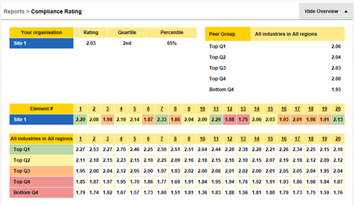
STEP 2: EIPSS - EI PROCESS SAFETY SURVEY
Online EI Process Safety Survey (EIPSS) service run by EIPSS Ltd. with support of EI.
Aligned to content of EI PSMF.
Much more than a ‘survey’ and provides:
Self-assessment of compliance with EI PSMF Expectations.
Benchmarking against selectable internal peer groups.
Benchmarking against selectable industry sector and geographical peer groups.
Real time information.
Participants can join at any time.
Independent - Energy Institute.
Anonymity assurance.
Does not require EI Membership.
www.energyinst.org

Slide 18
STEP 2: WHY EIPSS?
EIPSS enables senior executives and managers to:
Understand how likely they are to have ‘an incident free day tomorrow’.
Have a clear and consistent understanding of compliance and performance levels across their organisations on an absolute basis and relative to their peers.
Identify areas of strength and weakness vs. a recognised framework.
Have a robust basis for developing compliance/performance improvement plans.
Meet business challenges like:
Ageing assets.
Changing regimes (maintenance, etc.).
Margin pressure.
Merger and acquisition activity (seller and buyer side due diligence).
www.energyinst.org

Slide 19
STEP 2: EIPSS APPLICATION
EIPSS can be applied to:
Any region (geography)
Any industry sector:
Oil and gas – E&P through to filling stations
Chemical manufacturing and storage
Power – Generation through to distribution
EIPSS implementation/application:
Agnostic to HS&EMS being used.
Can be adapted to organisation criteria or regulator criteria (e.g. inspection programmes).
www.energyinst.org

Slide 20
STEP 2: EIPSS ASSESSMENT PROCESS 3 PHASES
The EIPSS assessment process answers 3 questions:
Phase 1 – Preliminary Assessment: “Do we say what we do?” A ‘light touch’ assessment of compliance with the expectations of EI PSMF. Subjective/opinion based (202 questions)
Phase 2 – Detailed Documented Assessment: “Have we documented what we say we do and does this comply with the expectations of EI PSMF?” – that is, has the company got documented arrangements for the management of PSM which comply with the expectations of the framework? Evidence-based
Phase 3 – Detailed Implemented Assessment: “Does what we do comply with the expectations of the EI PSMF?” – is there evidence that what is actually done by the company’s assets meets the expectations of the framework? Evidence-based
www.energyinst.org

Slide 21
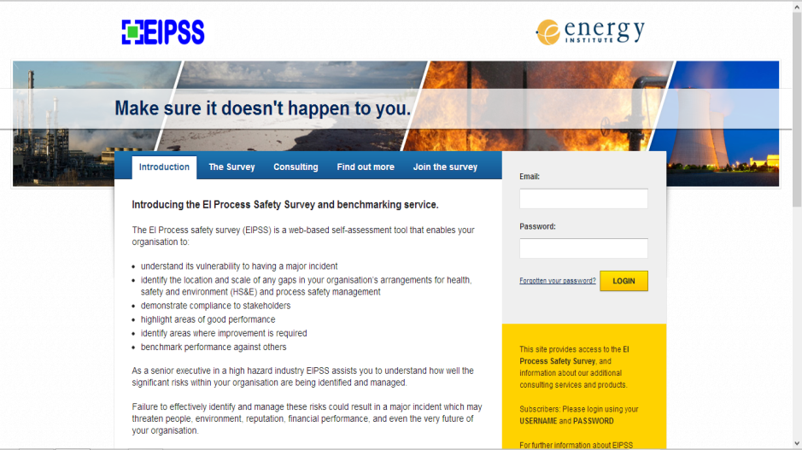
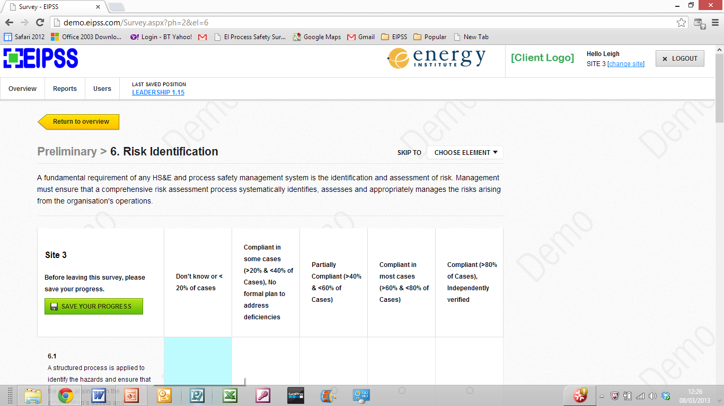
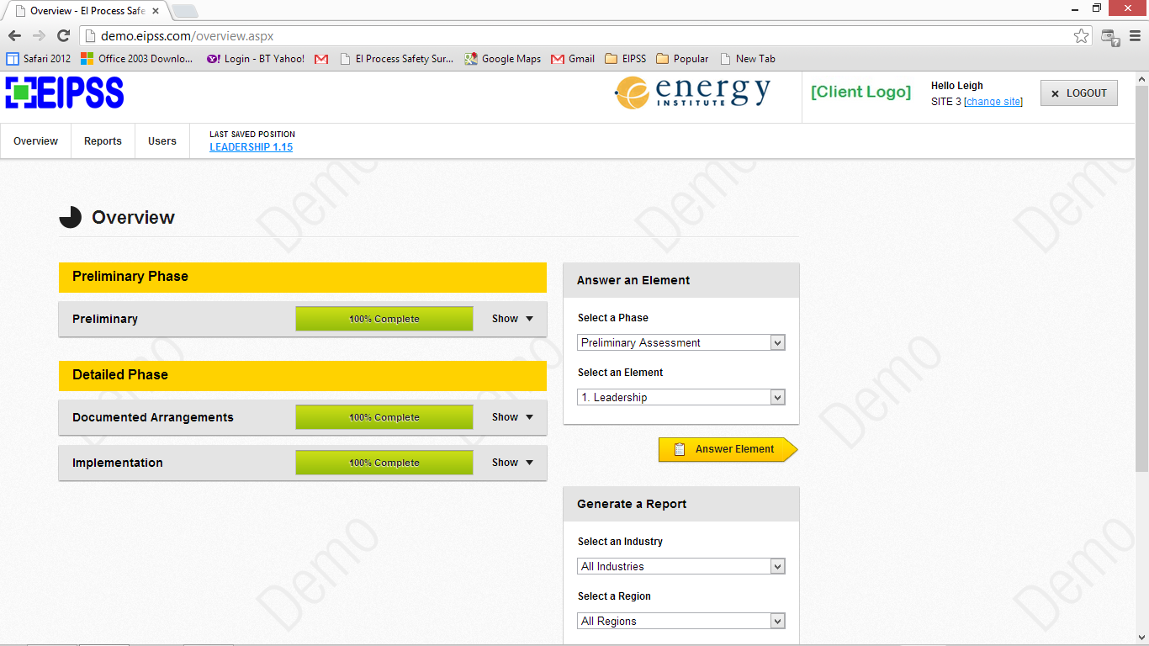
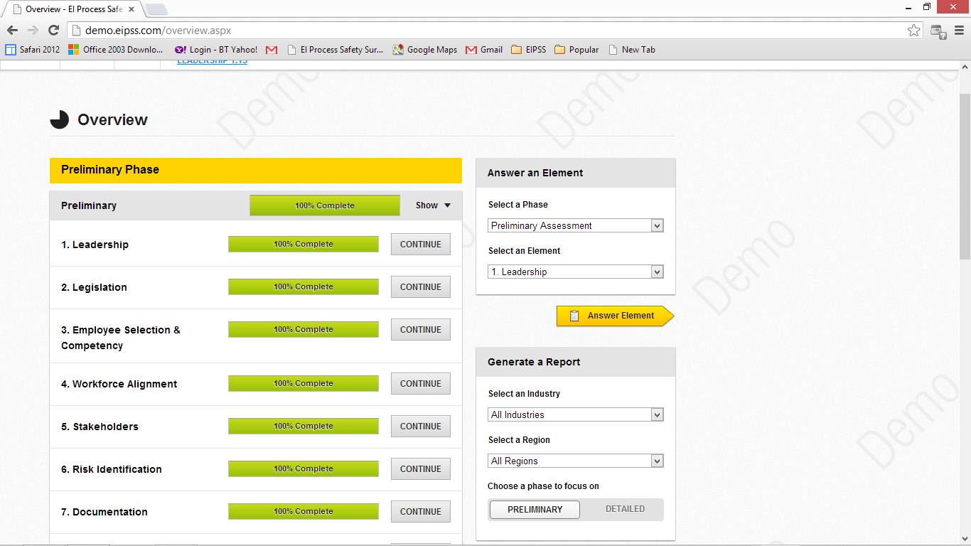
STEP 2: EIPSS ASSESSMENT
Secure, real-time web-based tool
Multiple choice answers based on a scale of compliance
Phased approach
Questions for 20 elements
and 202 expectations
www.energyinst.org

Slide 22
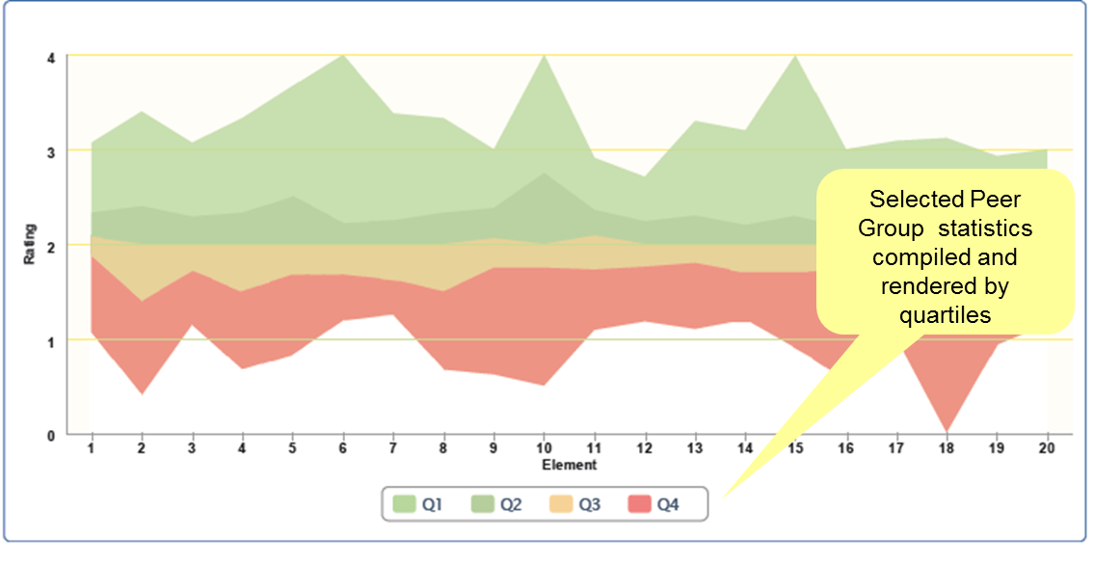
STEP 2: EIPSS OUTPUT
EIPSS output – Industry sector & geography selectable – for all elements
www.energyinst.org

Slide 23
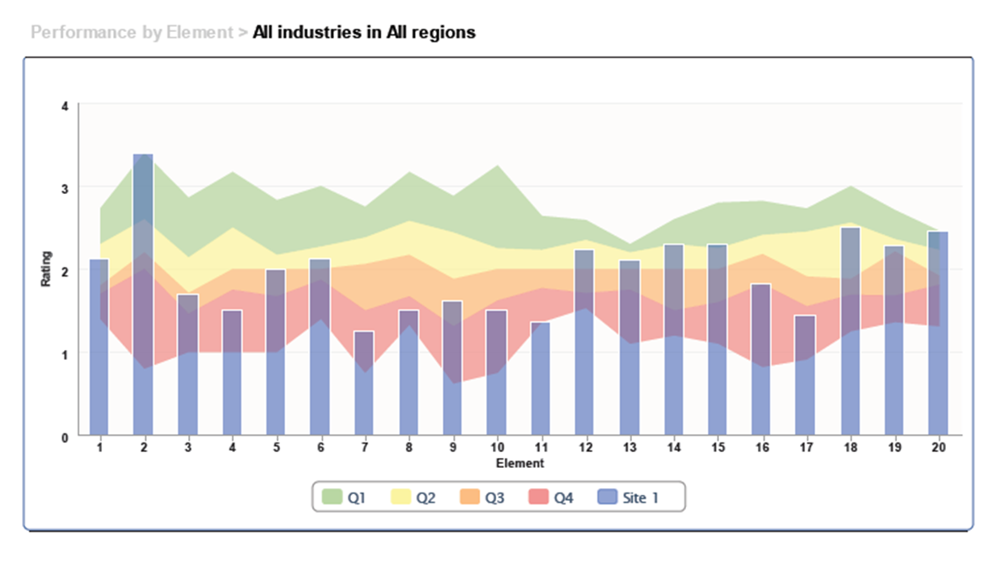
STEP 2: EIPSS OUTPUT
Profile is absolute in respect to EI PSMF
and relative in respect to selected peer group
Process Safety Profile for Site 1 (blue columns) across elements 1-20, overlaid on selected peer group statistics
www.energyinst.org

Slide 24
STEP 2: ROOM FOR IMPROVEMENT
4
Company B
Maintenance of safety critical devices
Operating manuals & procedures
Incident reporting & investigation
Company C
3
Emergency preparedness
Inspection & maintenance
Standards & practices
2
1
Company A
1
2
3
4
5
6
7
8
9
10
11
12
13
14
15
16
17
18
19
20
EI PSMF element
Results from companies assessed since Q4 2012
www.energyinst.org

Slide 25
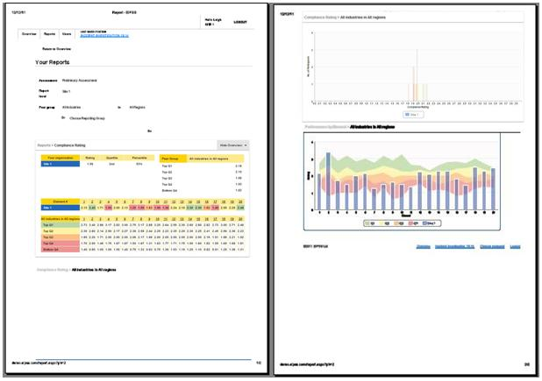
EIPSS OUTPUT
Report
STEP 2: EIPSS OUTPUT - REPORT
Tabular
Overall rating
Position in peer group
Peer group quartile boundaries
Appropriate next level of detail
Ratings for each Element or Expectation.
Peer group quartile boundaries for next level of detail.
Graphical
Peer group “Overall rating” distribution curve.
Appropriate next level of detail
Ratings for each Element or Expectation overlaid on peer group performance quartiles.
Process Safety Profile with drill-down to detail
www.energyinst.org

Slide 26
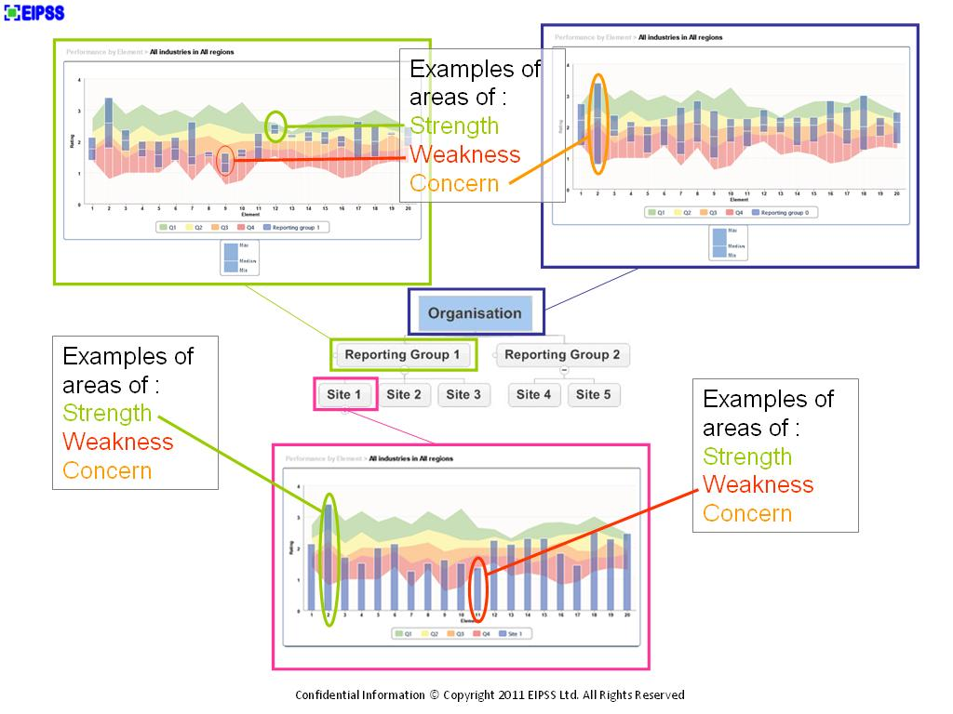
STEP 2: CORPORATE EIPSS
The EIPSS works at all levels of businesses - large and small.
Preliminary assessments can be followed up with Detailed assessment of documentation made at Corporate level and Detailed assessments of implementation at asset level.
The tool automatically collates the results of asset level assessments at regional/divisional and corporate levels.
www.energyinst.org

Slide 27
STEP 2: EIPSS ASSESSMENT – IMPLEMENTATION APPROACH
Self-assessment …… and/or
Consultant facilitated workshop designed to transfer knowledge of EIPSS operation to company participants:
Preliminary assessment workshop
~2 days, 1-5 participants full-time
Detailed documentation assessment workshop
½-day per element, participants scheduled as necessary
Detailed implementation assessment workshop
½-day per element, participants scheduled as necessary
www.energyinst.org

Slide 28
PRESENTATION TOPICS
5 Good practice steps to effective PSM
EI PSM framework (PSMF)
EI Process Safety Survey (EIPSS)
EI PSM guidelines (PSMG)
Performance measures
Competency profiles programme
www.energyinst.org

Slide 29
STEP 3: PSMG
EI PSM guidelines (PSMG):
A series of 20 publications (‘guidelines’) that build on EI PSMF and help organisations to close gaps in PSM arrangements.
Capture industry good practices and present current guidance on how organisations can meet the expectations set out in each element of the PSMF.
One publication for each element: 2 published, 15 more drafted.
Guidance on meeting expectations of EI process safety management framework: Element X [title]
See www.energyinst.org/psmguidelines
www.energyinst.org

Slide 30
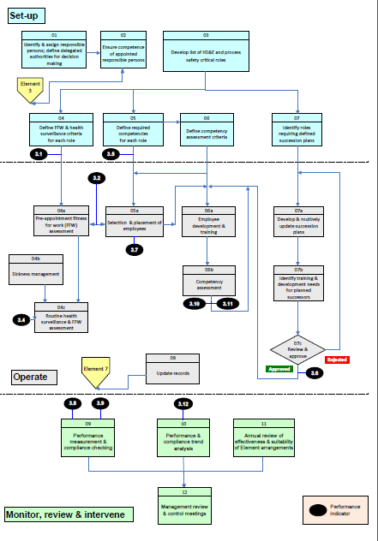
STEP 3: PSMG - GAP CLOSURE
Each PSMG includes:
A logical flow diagram of activities (‘steps’) the organisation should undertake to manage that element based on:
set-up;
operate, and
monitor, review and intervene
Descriptions of those steps;
Example performance measures (PMs) to measure the extent to which key steps have been undertaken – see Step 4 of the 5 Step PSM process;
A list of further resources to help undertake key steps.
A table mapping the steps against the expectations in the EI PSMF.
Annexes of useful information (e.g. forms).
www.energyinst.org

Slide 31
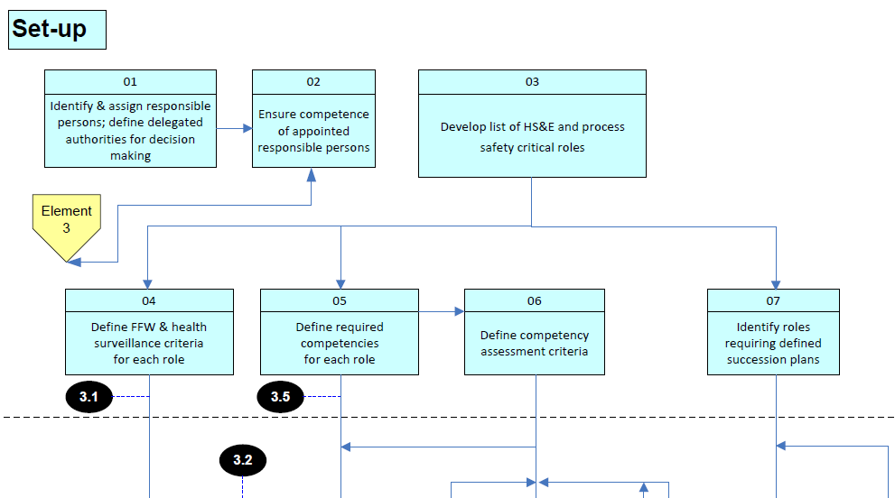
STEP 3: PSMG - GAP CLOSURE
Extract from process flow diagram for Element 3 from Guidance on meeting expectations of EI Process safety management framework - Element 3: Employee selection, placement and competency, and health assurance
www.energyinst.org

Slide 32
PRESENTATION TOPICS
5 Good practice steps to effective PSM
EI PSM framework (PSMF)
EI Process Safety Survey (EIPSS)
EI PSM guidelines (PSMG)
Performance measures
Competency profiles programme
www.energyinst.org

Slide 33
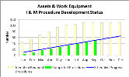
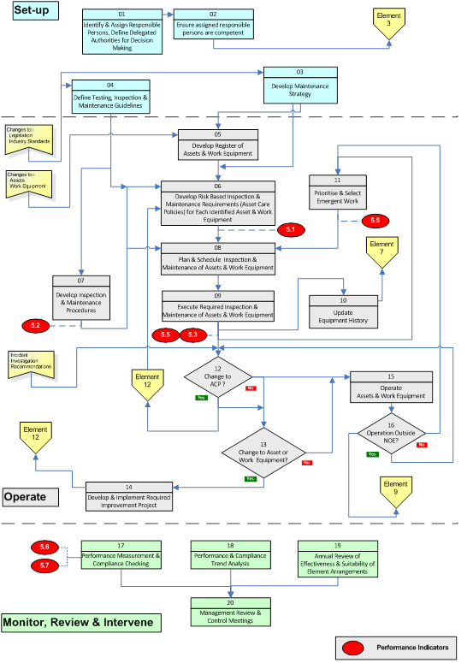
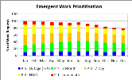
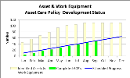
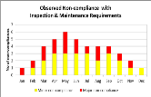
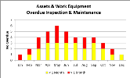
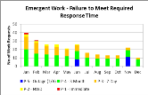
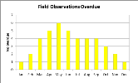
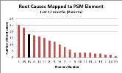
STEP 4: PERFORMANCE MEASURES
Performance Measures (PMs) or Process Safety Performance Indicators (PSPIs) address issues which should be controlled (by someone) as part of managing process safety in order to manage the risk of incidents
PSMGs include PMs on process flow charts, and then describes them and suggests how they should be presented, e.g. using EIPSS charts.
PMs are either ‘compliance and implementation’, ‘operational’ or ‘outcome’.
www.energyinst.org

Slide 34

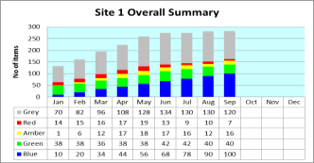
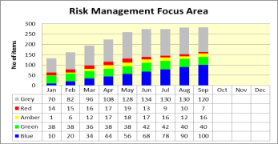
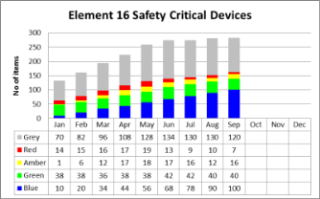
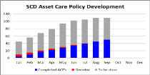

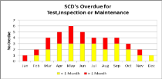
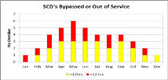
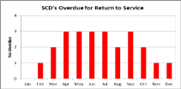
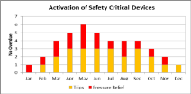
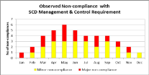
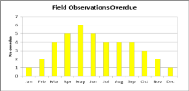
STEP 4: MEASURING PSM PERFORMANCE
Corporate
and/or site summary
4 Focus Area Summaries
Focus area summary
2 - 11 Element Summaries
Predominantly leading indicators:
real-time, and
on-line.
Element
summary
Detailed PMs for each of 20 elements
www.energyinst.org

Slide 35
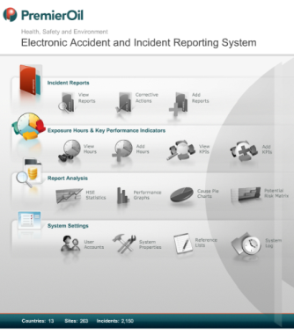
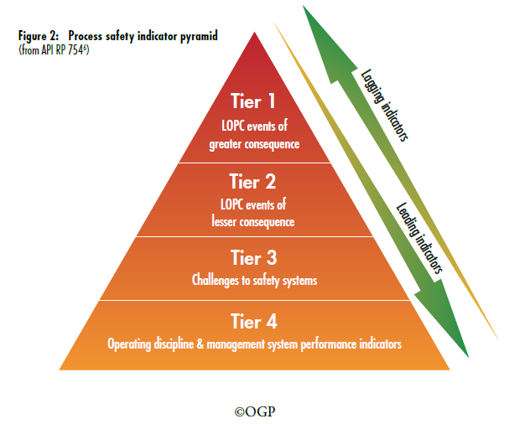
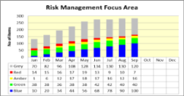

STEP 4: API RP 754 PROCESS SAFETY PYRAMID
- Leading and Lagging indicators
LOPC Tier 1 (Lagging)
LOPC Tier 2 (Lagging)
Shutdown Log
LOPC HiPos (Lagging)
EIPSS¦o
Safety system activation
(Leading)
CMMS
Asset Integrity MS
Degraded safety critical
barriers (Leading)
Process Safety MS
(Leading)
Framework
&
EIPSS¦a
www.energyinst.org

Slide 36

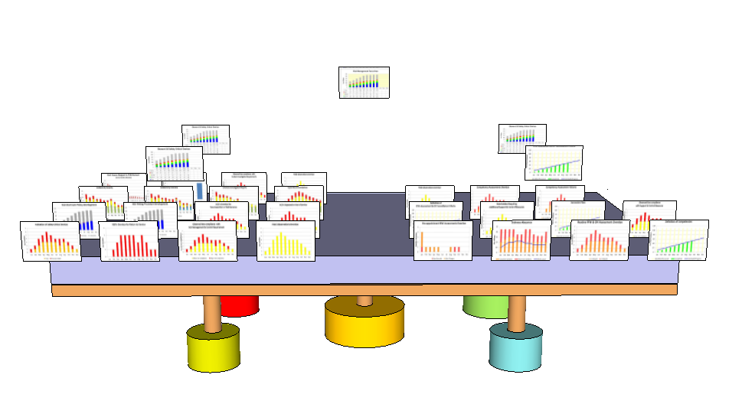
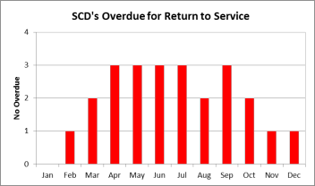
STEP 4: PSPIs/KPIs & AGGREGATION PERFORMANCE MEASURES - TIER 3 & 4
PSPIs collated and intelligently aggregated as meaningful KPIs at different levels
Typical data from existing systems and activities as PSPIs/KPIs
Typical data acquisition & modelling layers (Siemens, Invensys, GE, etc.)
Typical operational data sources – SAP, Oracle, Maximo, etc.
www.energyinst.org

Slide 37
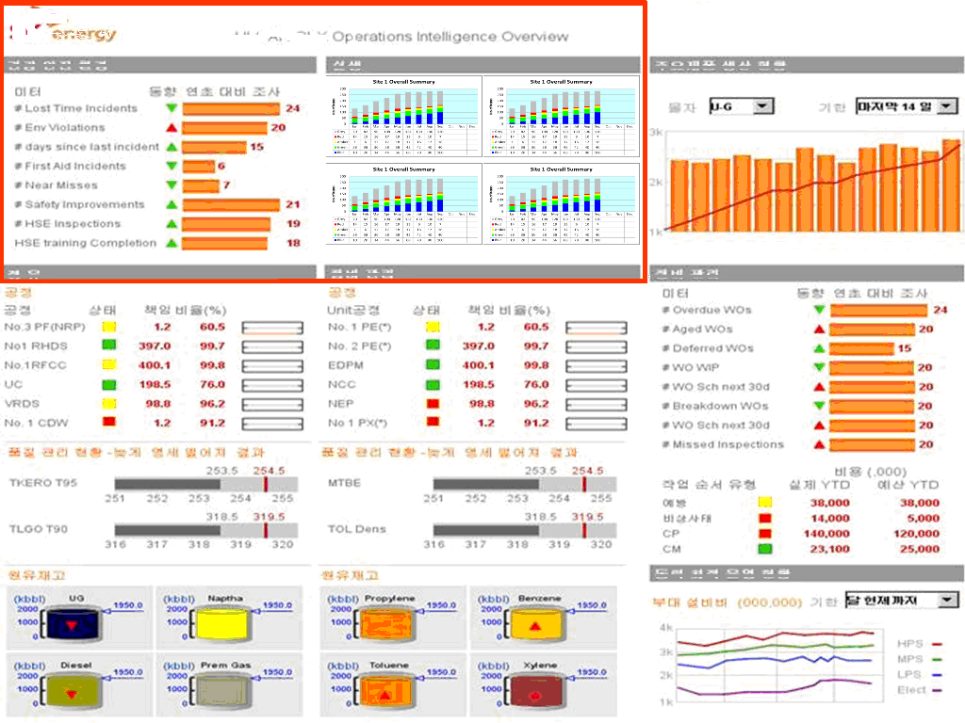
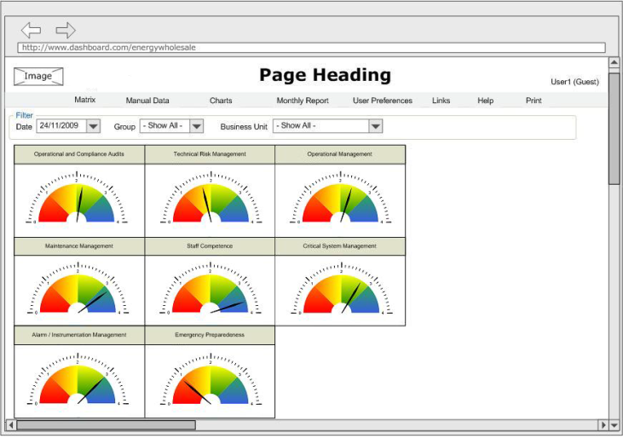
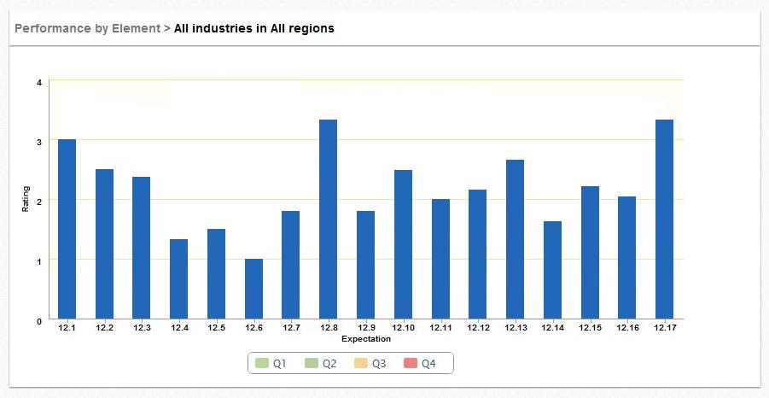
STEP 4: PSPIs/KPIs & AGGREGATION PERFORMANCE MEASURES - TIER 3 & 4
PSM KPIs integrated with
industrial safety KPIs in
company KPI dashboard
e.g. Siemens, Invensys, etc.
EIPSS scores
provide
strategic &
tactical KPIs
www.energyinst.org

Slide 38
PRESENTATION TOPICS
5 Good practice steps to effective PSM
EI PSM framework (PSMF)
EI Process Safety Survey (EIPSS)
EI PSM guidelines (PSMG)
EI Performance measures
EI/EIPSS Competency profiles programme
www.energyinst.org

Slide 39
STEP 5: COMPETENCE PROFILES PROGRAMME
Defining competence requirements for various professional job roles to support Element 3.
Initially for an upstream organisation E&P company and power generation operations.
Provides basis for competency in PSM.
Aids effective succession planning.
EI to publish deliverable mid 2014.
www.energyinst.org

Slide 40
PRESENTATION TOPICS
5 Good practice steps to effective PSM
EI PSM framework (PSMF)
EI Process Safety Survey (EIPSS)
EI PSM guidelines (PSMG)
Performance measures
Competency profiles programme
www.energyinst.org

Slide 41
EI Middle East Branch
Good practice steps to effective PSM
How do you know you’ll have an incident-free day tomorrow?
Dr. Mark Scanlon – HSE Team Manager – Energy Institute
11/11/2013
www.energyinst.org

